Slide 1

“Image Signal Compression”
Mikołaj Leszczuk
10.03.2025

Slide 2
Introduction to Signal Compression
Definition: reducing irrelevance and redundancy of (multimedia) data
Objective: to be able to store or transmit data in efficient form
Notes:
In signal processing, data compression, source coding, or bit-rate reduction is the process of encoding information using fewer bits than the original representation. Compression is useful because it reduces resources required to store and transmit data.

Slide 3
Lossless or Lossy?
Lossless
Lossy
Introducing no artefacts
Low compression rates
Methods:
LZ77
Huffman coding
Preferred applications:
Archival purposes
Professional segment
Elementary signals
Computer-generated media
Introducing some artefacts
High compression rates
Methods:
Reducing signal space
Signal subsampling
Transform coding
Fractal compression
Preferred applications:
Low bit rates
Popular segment
Natural signals
Notes:
Any particular compression is either lossy or lossless. Lossless compression reduces bits by identifying and eliminating statistical redundancy. No information is lost in lossless compression. Lossy compression reduces bits by removing unnecessary or less important information. Typically, a device that performs data compression is referred to as an encoder, and one that performs the reversal of the process (decompression) as a decoder.

Slide 4
Perceptually Lossless?
Lossy compression producing imperceptible differences

Slide 5
Standardisation
Moving Picture Experts Group
Joint Photographic Experts Group
Notes:
The Moving Picture Experts Group (MPEG) is a working group of authorities that was formed by ISO and IEC to set standards for audio and video compression and transmission.
The Joint Photographic Experts Group (JPEG) is the joint committee between ISO/IEC JTC 1 and ITU-T (formerly CCITT) that created and maintains the JPEG, JPEG 2000, and JPEG XR standards.

Slide 6
Why Image Signal Compression?
Uncompressed (“raw”) image (8 MP): ∼24 MB
Compression required!
Compressed image (8 MP): ∼3 MB
Achieved image compression ratio: ∼1:10

Slide 7
General Scheme of Image Compression
Original data representing image
Compressed data representing image
Transmission or storage
Compressed data representing image
Decoder (decompression, decryption)
Encoder (compression, encryption)
Reconstructed data representing image

Slide 8
Image Compression Process
Source Image
Lossy Compression?
Processed Image
Lossless Compression
CC BY-SA 3.0, https://commons.wikimedia.org/w/index.php?curid=1477228

Slide 9
Lossy Methods (1/2)
Reducing colour space to most common colours
Chroma subsampling:
Averaging, or
Dropping
CC BY-SA 3.0, https://commons.wikimedia.org/w/index.php?curid=1477225
Notes:
A color space is a specific organization of colors. In combination with physical device profiling, it allows for reproducible representations of color, in both analog and digital representations. A color space may be arbitrary, with particular colors assigned to a set of physical color swatches and corresponding assigned color names or numbers (such as with the Pantone collection), or structured mathematically (as with the NCS System, Adobe RGB and sRGB).
Chroma subsampling is the practice of encoding images by implementing less resolution for chroma information than for luma information, taking advantage of the human visual system's lower acuity for color differences than for luminance.

Slide 10
Lossy Methods (2/2)
Transform coding (most common):
Discrete Cosine Transform (DCT) – Joint Photographic Experts Group (JPEG)
Discrete Wavelet Transform (DWT) – JPEG2000
Fractal compression
Notes:
Transform coding is a type of data compression for "natural" data like audio signals or photographic images. The transformation is typically lossless (perfectly reversible) on its own but is used to enable better (more targeted) quantization, which then results in a lower quality copy of the original input (lossy compression).
In transform coding, knowledge of the application is used to choose information to discard, thereby lowering its bandwidth. The remaining information can then be compressed via a variety of methods. When the output is decoded, the result may not be identical to the original input, but is expected to be close enough for the purpose of the application.

Slide 11
Lossless Methods
RLE
PCX
BMP
TGA
TIFF
Area image compression
DPCM & Predictive Coding
Entropy encoding
LZW
GIF
TIFF
Deflation
PNG
MNG
TIFF
Chain codes
Notes:
Run-Length Encoding (RLE, common):
Default in Picture Exchange (PCX)
Possible in:
Bitmap (BMP)
Truevision TARGA (TGA)
Tag Image File Format (TIFF)
Area image compression
Differential Pulse-Code Modulation (DPCM) and Predictive Coding
Entropy encoding
Adaptive dictionary algorithms, like Lempel–Ziv–Welch (LZW) – used in:
Graphics Interchange Format (GIF)
TIFF
Deflation (common) – used in:
Portable Network Graphics (PNG)
Multiple-image Network Graphics (MNG)
TIFF
Chain codes

Slide 12
Use of Colour Space Transmission Coordinates
From RGB
To YCbCr:
Y – luminance
CbCr – chroma
Sensor
RGB
Processor
YCbCr
Transmission or storage
Processor
YCbCr
RGB
Screen
Notes:
Color space conversion is the translation of the representation of a color from one basis to another. This typically occurs in the context of converting an image that is represented in one color space to another color space, the goal being to make the translated image look as similar as possible to the original.

Slide 13
Down-Sampling
4:4:4 (no down-sampling)
4:2:2 (½ horizontal)
4:2:0 (½ horizontal & vertical)
Notes:
In digital signal processing, downsampling, compression, and decimation are terms associated with the process of resampling in a multi-rate digital signal processing system. Both downsampling and decimation can be synonymous with compression, or they can describe an entire process of bandwidth reduction (filtering) and sample-rate reduction. When the process is performed on a sequence of samples of a signal or other continuous function, it produces an approximation of the sequence that would have been obtained by sampling the signal at a lower rate (or density, as in the case of a photograph).

Slide 14
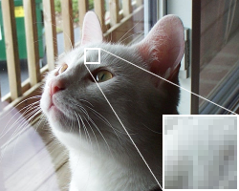
DCT Block Splitting
Further – DCT compression, only block-based
Each channel split into blocks
CC BY-SA 3.0, https://commons.wikimedia.org/w/index.php?curid=1477223
Notes:
A discrete cosine transform (DCT) expresses a finite sequence of data points in terms of a sum of cosine functions oscillating at different frequencies. The DCT, first proposed by Nasir Ahmed in 1972, is a widely used transformation technique in signal processing and data compression. It is used in most digital media, including digital images (such as JPEG and HEIF, where small high-frequency components can be discarded), digital video (such as MPEG and H.26x), digital audio (such as Dolby Digital, MP3 and AAC), digital television (such as SDTV, HDTV and VOD), digital radio (such as AAC+ and DAB+), and speech coding (such as AAC-LD, Siren and Opus). DCTs are also important to numerous other applications in science and engineering, such as digital signal processing, communications devices, reducing network bandwidth usage, and spectral methods for the numerical solution of partial differential equations.

Slide 15
DCT 8×8 Sub-Image Shown in 8-Bit Grey-Scale
Block size depending on chroma subsampling:
8×8 (4:4:4)
16×8 (4:2:2)
16×16 (4:2:0)
Block in visual compression:
Image: Minimum Coded Unit (MCU)
Video: Macroblock
Notes:
After subsampling, each channel must be split into 8×8 blocks. Depending on chroma subsampling, this yields Minimum Coded Unit (MCU) blocks of size 8×8 (4:4:4 – no subsampling), 16×8 (4:2:2), or most commonly 16×16 (4:2:0). In video compression MCUs are called macroblocks.

Slide 16
Actual DCT (1/2)
Each (e.g., 8×8) block converted to frequency-domain representation
Using normalized, 2D DCT
Before computing DCT of 8×8 block, its values shifted:
From positive range
To one centred around zero
Notes:
Next, each 8×8 block of each component (Y, Cb, Cr) is converted to a frequency-domain representation, using a normalized, two-dimensional type-II discrete cosine transform (DCT). The DCT is sometimes referred to as "type-II DCT" in the context of a family of transforms as in discrete cosine transform, and the corresponding inverse (IDCT) is denoted as "type-III DCT".
As an example, one such 8×8 8-bit subimage might be the one on the left-hand side.

Slide 17

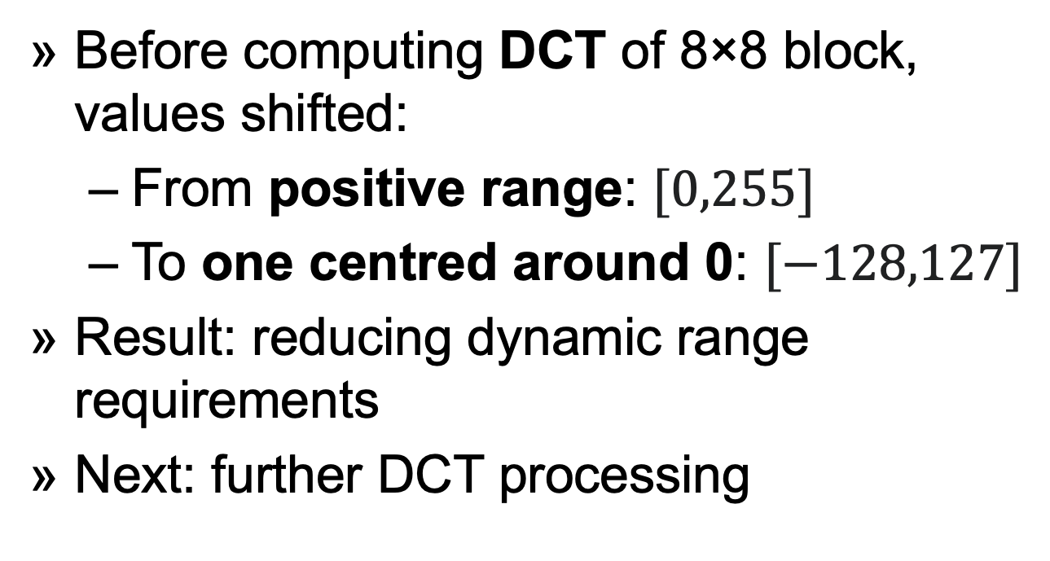
Actual DCT (2/2)
Before computing DCT of 8×8 block, values shifted:
From positive range: $[0,255]$
To one centred around 0: $[−128,127]$
Result: reducing dynamic range requirements
Next: further DCT processing
Notes:
Before computing the DCT of the 8×8 block, its values are shifted from a positive range to one centered on zero. For an 8-bit image, each entry in the original block falls in the range [0,255]. The midpoint of the range (in this case, the value 128) is subtracted from each entry to produce a data range that is centered on zero, so that the modified range is [−128,127]. This step reduces the dynamic range requirements in the DCT processing stage that follows.
This step results in the following values (like on the left-hand side).

Slide 18
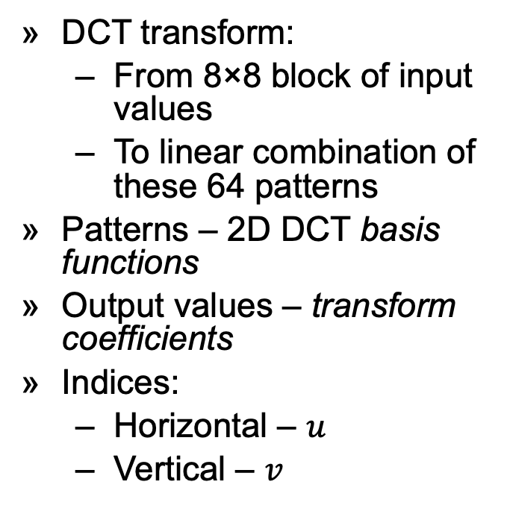
Linear Combination of 64 Patterns
DCT transform:
From 8×8 block of input values
To linear combination of these 64 patterns
Patterns – 2D DCT basis functions
Output values – transform coefficients
Indices:
Horizontal – $u$
Vertical – $v$
Notes:
The next step is to take the two-dimensional DCT.
The DCT transforms an 8×8 block of input values to a linear combination of these 64 patterns. The patterns are referred to as the two-dimensional DCT basis functions, and the output values are referred to as transform coefficients. The horizontal index is u and the vertical index is v.

Slide 19
DCT Transforming 8×8 Block of Input Values
Transformation on our previous matrix
Top-left corner with large magnitude
DC coefficient, defining block hue
Remaining 63 coefficients – AC coefficients
DCT increasing bit-depth of data
Typically reduced by quantization step
Notes:
If we perform this transformation on our matrix above, we get the following (rounded to the nearest two digits beyond the decimal point).
Note the top-left corner entry with the rather large magnitude. This is the DC coefficient (also called the constant component), which defines the basic hue for the entire block. The remaining 63 coefficients are the AC coefficients (also called the alternating components). The advantage of the DCT is its tendency to aggregate most of the signal in one corner of the result, as may be seen above. The quantization step to follow accentuates this effect while simultaneously reducing the overall size of the DCT coefficients, resulting in a signal that is easy to compress efficiently in the entropy stage.
The DCT temporarily increases the bit-depth of the data, since the DCT coefficients of an 8-bit/component image take up to 11 or more bits (depending on fidelity of the DCT calculation) to store. This may force the codec to temporarily use 16-bit numbers to hold these coefficients, doubling the size of the image representation at this point; these values are typically reduced back to 8-bit values by the quantization step. The temporary increase in size at this stage is not a performance concern for most JPEG implementations, since typically only a very small part of the image is stored in full DCT form at any given time during the image encoding or decoding process.

Slide 20
DCT Quantization
Seeing artefacts by human eye:
Good at large areas
Bad at high frequencies
Allowing to reduce high frequencies
Notes:
Quantization, involved in image processing, is a lossy compression technique achieved by compressing a range of values to a single quantum value. When the number of discrete symbols in each stream is reduced, the stream becomes more compressible. For example, reducing the number of colours required to represent a digital image makes it possible to reduce its file size. Specific applications include DCT data quantization in JPEG and DWT data quantization in JPEG 2000.

Slide 21
Lossless Compression (Entropy Coding)
Special form of lossless data compression
Involving:
Arranging components in “zigzag” order
Using RLE to group similar frequencies together
Inserting length coding zeroes
Using Huffman coding on what is left
Figure: zigzag ordering of frame components
Notes:
In information theory an entropy encoding is a lossless data compression scheme that is independent of the specific characteristics of the medium.
One of the main types of entropy coding creates and assigns a unique prefix-free code to each unique symbol that occurs in the input. These entropy encoders then compress data by replacing each fixed-length input symbol with the corresponding variable-length prefix-free output codeword. The length of each codeword is approximately proportional to the negative logarithm of the probability. Therefore, the most common symbols use the shortest codes.

Slide 22
JPEG Quality
A photo of cat
Relative quality of various JPEG settings
Compression rate ↑ (quality ↓)
Left to right
"Felis silvestris silvestris small gradual decrease of quality" by Felis_silvestris_silvestris.jpg: Michael Gäblerderivative work: AzaToth – Felis_silvestris_silvestris.jpg. Licensed under CC BY 3.0 via Commons – https://commons.wikimedia.org/wiki/File:Felis_silvestris_silvestris_small_gradual_decrease_of_quality.png#/media/File:Felis_silvestris_silvestris_small_gradual_decrease_of_quality.png

Slide 23
JPEG Mini
Finding optimal parameters for the compressor for each image
Image optimization technology
Reducing size of JPEGs by up to 5- or 6-times original size
Maintaining resolution and perceived quality
Imitating very closely qualities of Human Visual System (HVS)
Applying optimal amount of compression to each photo
Notes:
JPEGmini is a Photo Optimization software product created in 2011 that is said to compress the file size of JPEG photos by approximately a factor of two to three, sometimes more, with minimal or imperceptible degradation in image quality.

Slide 24
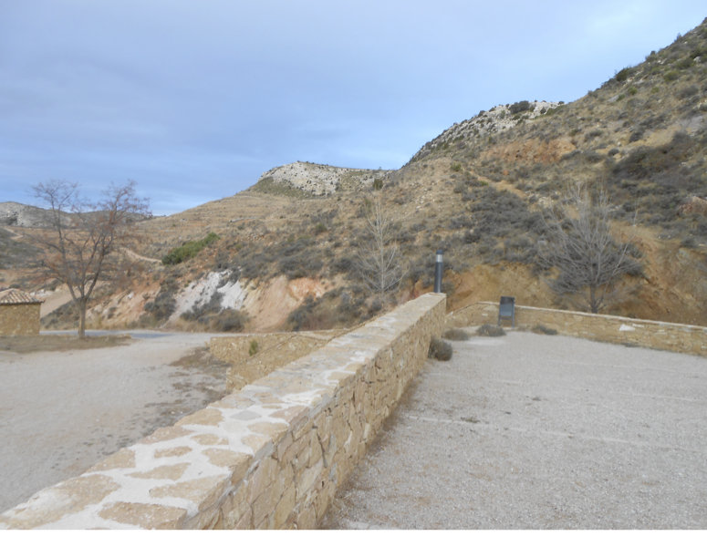
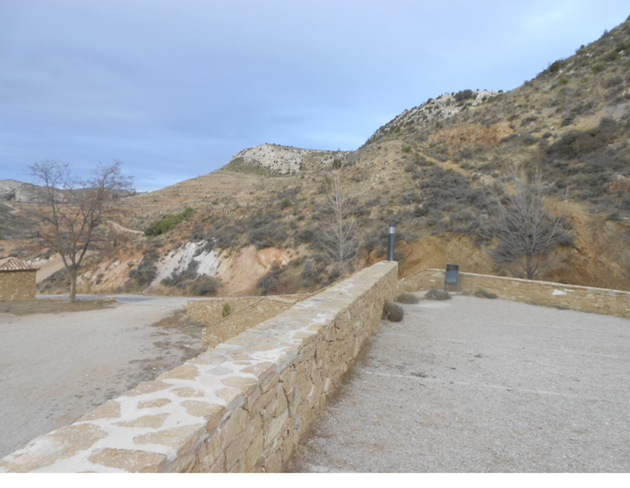
JPEG Mini Compression Test
JPEG
JPEG Mini (5x-6x reduced)
Notes:
JPEGmini technology has two main components: The first is an image quality detector, which imitates the perceptual qualities of the human visual system, to determine the maximum amount of compression which can be applied to each individual photo without causing visible artifacts. The second is a unique JPEG encoder, which adapts the JPEG encoding process to the original photos, creating the most compact representation of the photos that is possible under the JPEG standard. Combining these two components enables JPEGmini to achieve an extremely high recompression ratio of up to 5x, or 80% reduction on digital photos, depending on their resolution. JPEGmini uses proprietary technology.ress the file size of JPEG photos by approximately a factor of two to three, sometimes more, with minimal or imperceptible degradation in image quality.

Slide 25
DCT Blockiness Artefact
Example macro-blockiness (blocking)
Error showing as low-resolution
Immanent feature of MCU
Solution: global compression with DWT
By Eduard.lopez-prat – Own work, CC BY-SA 3.0, https://commons.wikimedia.org/w/index.php?curid=17603194
Notes:
At low bit rates, any lossy block-based coding scheme introduces visible artefacts in pixel blocks and at block boundaries. These boundaries can transform block boundaries, prediction block boundaries, or both, and may coincide with macroblock boundaries. The term macroblocking is commonly used regardless of the artefact's cause. Other names include tiling, mosaicing, pixelating, quilting, and checkerboarding.

Slide 26
DWT
Wavelets discretely sample
Advantage over DCT – resolution
Capturing both frequency and location information
Artefacts less visible
Almost no blockiness
Notes:
In numerical analysis and functional analysis, a discrete wavelet transform (DWT) is any wavelet transform for which the wavelets are discretely sampled. As with other wavelet transforms, a key advantage it has over Fourier transforms been temporal resolution: it captures both frequency and location information (location in time).

Slide 27
Addition Reference
Damian Karwowski, „Zrozumieć Kompresję Obrazu”, Poznań 2019, https://www.zrozumieckompresje.pl/ (in Polish)

